Slide 1
Chapter- 11
FORCE AND PRESSURE
Part -1

Slide 2
Topics to be covered
Introduction
What is Force?
Effects of Force
Unit of Force

Slide 3
Introduction
Moving a book placed on table
Opening a door
Lifting a bucket filled with water
Opening a drawer
Kicking a football
Hitting the ball with the bat
What is common in all these situations?????

Slide 4
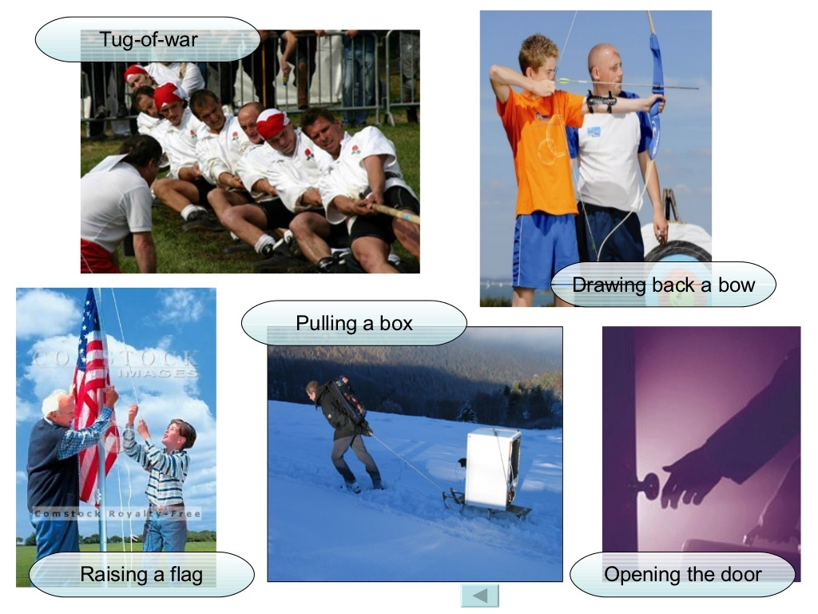

Slide 5


Slide 6
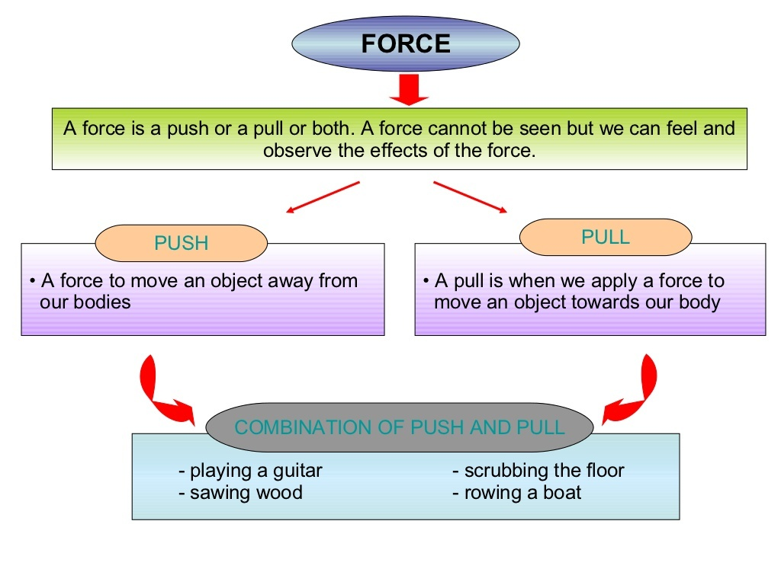

Slide 7
Without an interaction, the force cannot be applied to change the state of an object. Example :- If a book is lying on the table will remain on it until no external force is applied on it.

Slide 8
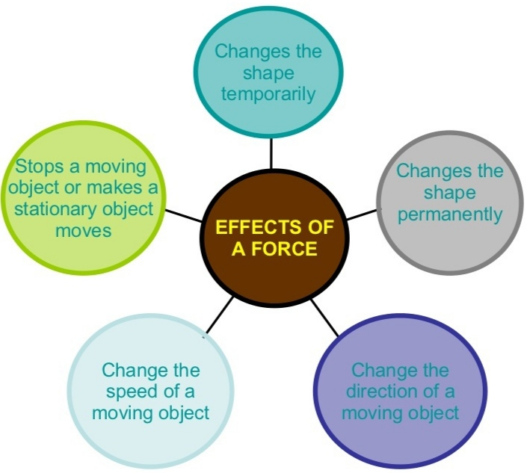

Slide 9
1. Force can cause motion in a stationary object
Book is lying on a table.
By applying force, book changes the position i.e., by push or pull.
Not necessary that force always make a stationary object move.
For eg. When you try to push the wall of your classroom, it will not move.
Because the force applied by you is not sufficient to move the wall.

Slide 10
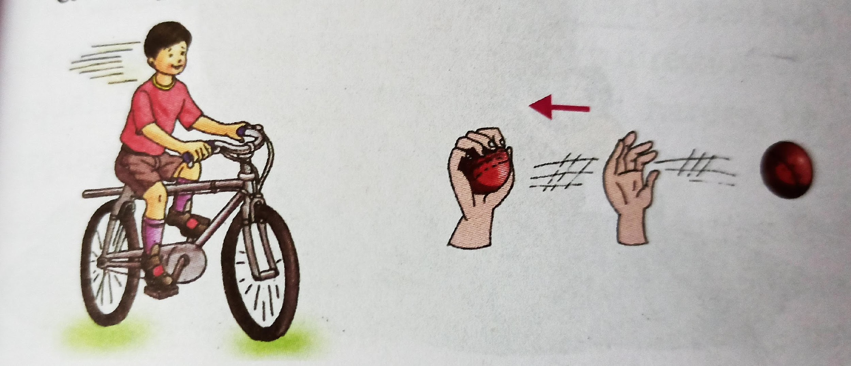
2. Force can stop a moving object
Football player kicks a football towards goal
Goalkeeper applies force to stop the ball.
A bicycle or car stops when you apply brakes.
Moving ball can stop and come to rest when you apply force with your hands.

Slide 11
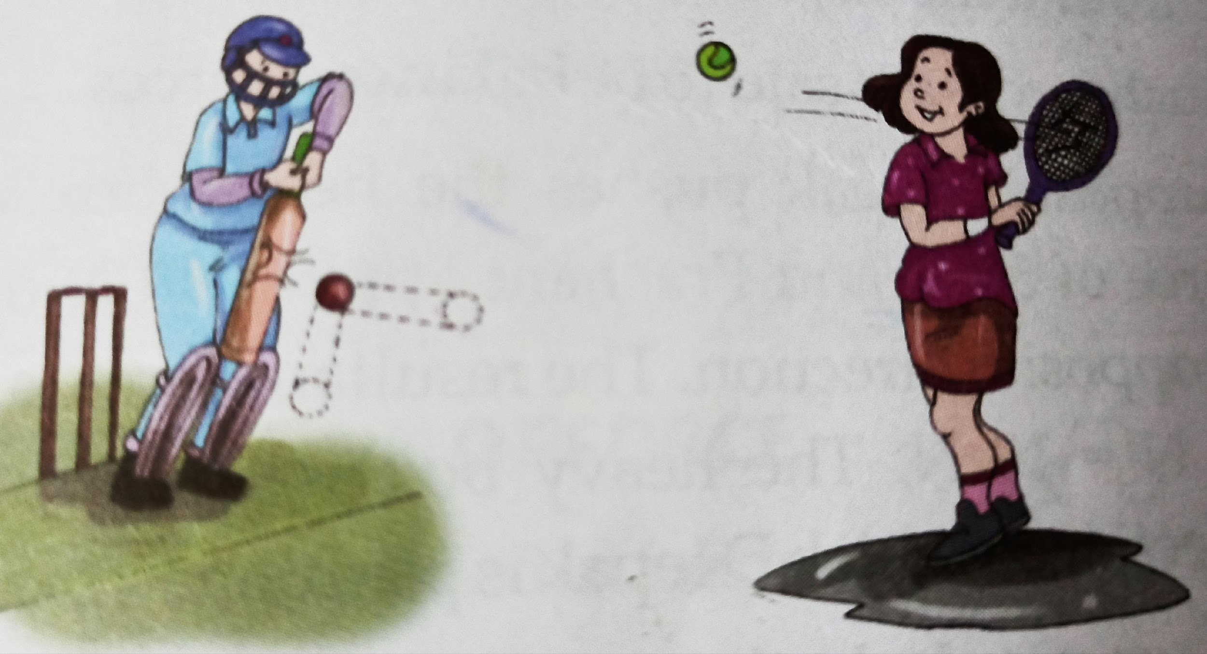
3. Force can change the direction of motion of a moving object
Batsman hits the ball with his bat.
Tennis player returns a service.
Both are changing the direction of ball by applying force.

Slide 12
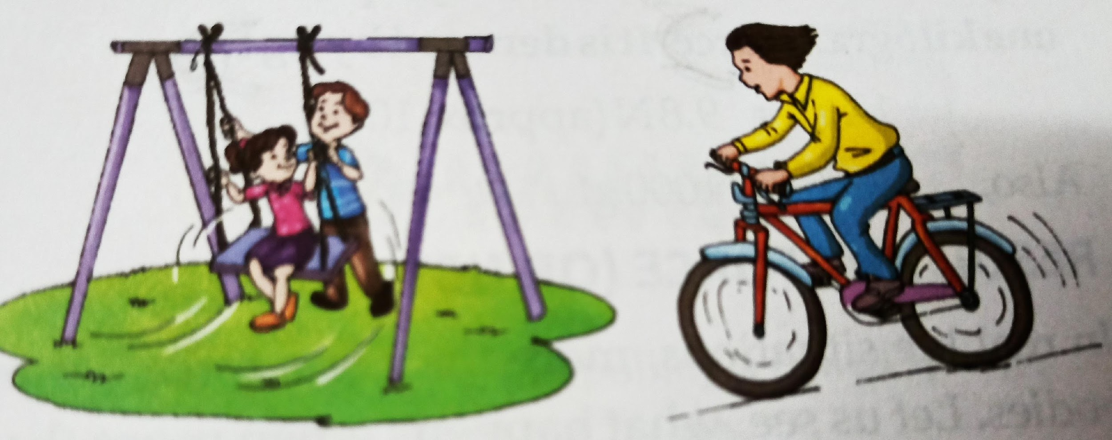
4. Force can change the speed of a moving object
Pushing a swing makes it move faster.
Pulling a swing in opposite directions makes it slow down.
Speed of the cycle increases when more force is applied on pedal.

Slide 13
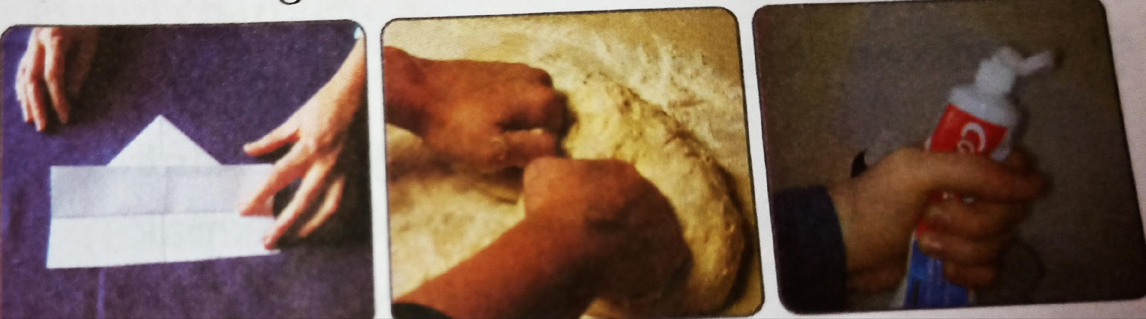
5. Force can change the shape and size of an object
Folding a piece of paper or clothes.
Knead flour.
Squeeze a tube of paint or toothpaste.
Shape & size of an object changes.

Slide 14
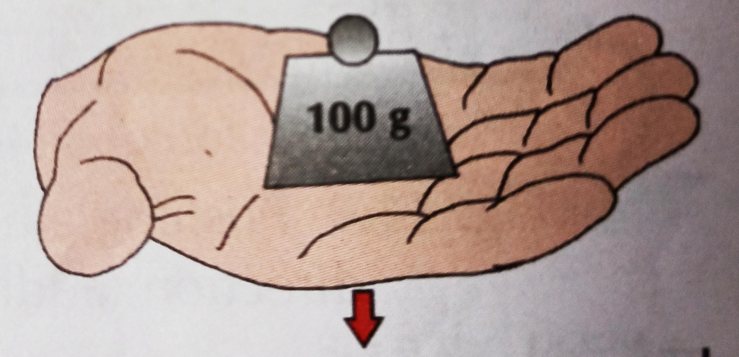
Units of Force
SI unit of force is Newton.
Denoted by letter N.
100g weight measure on your palm = One Newton (1N)
200g = 2 N.
Force required to lift an object of mass 1 kg vertically upward is called one kilogram force.
Denoted by kgf.
1kgf = 9.8 N
1kgf = 1000gf

Slide 15
Thank you for watching......😊😊😊😊

Slide 16
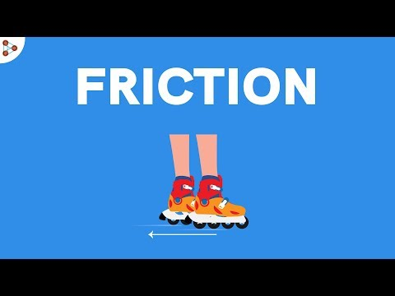

Slide 17
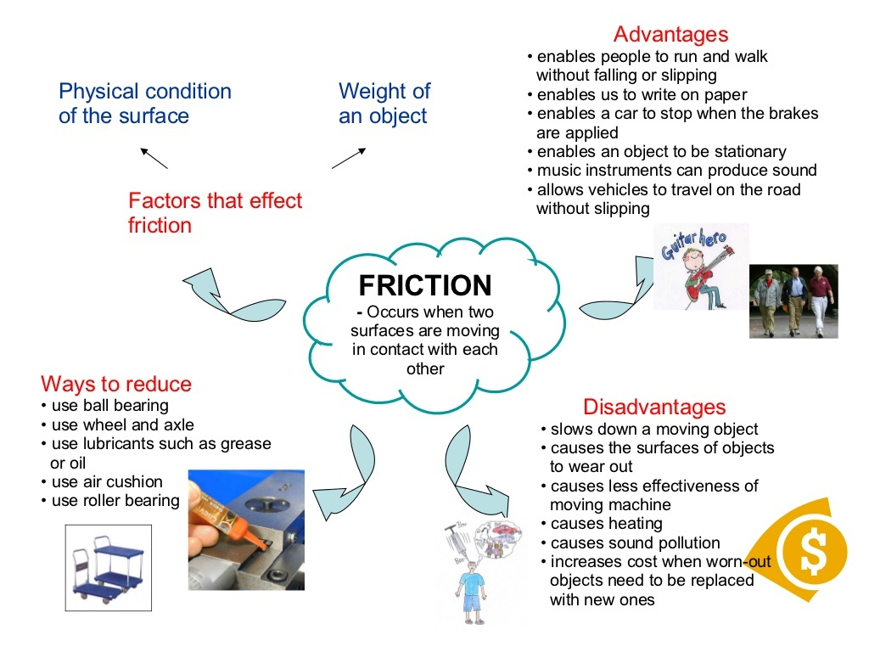

Slide 18
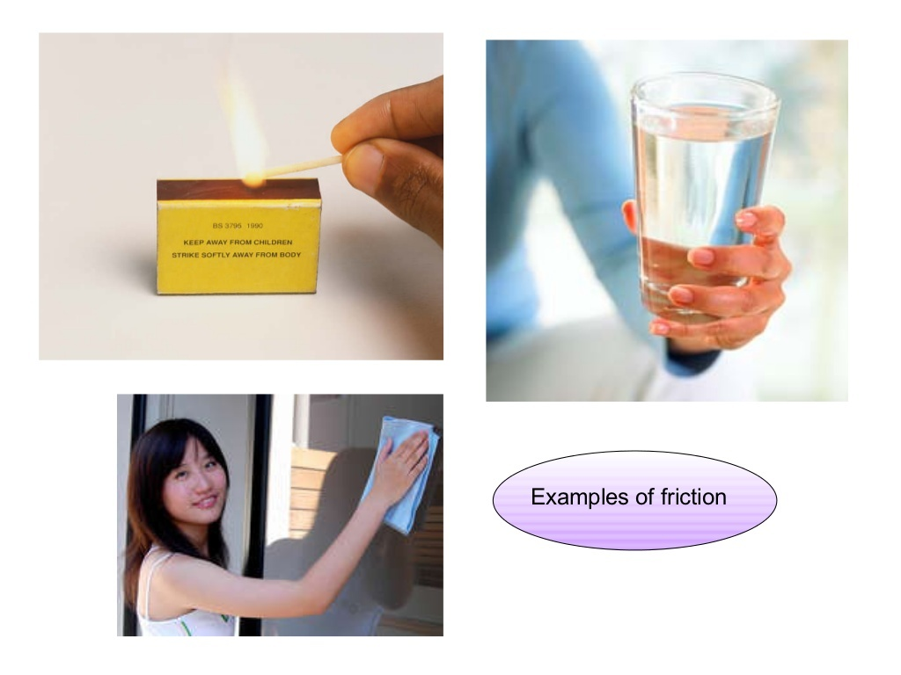

Slide 19
WHAT IS PRESSURE
Pressure is defined as the physical force exerted on an object. The force applied is perpendicular to the surface of objects per unit area. The basic formula for pressure is F/A (Force per unit area). Unit of pressure is Pascals (Pa). Types of Pressures are Absolute, Atmospheric, Differential, and Gauge Pressure.

Slide 20
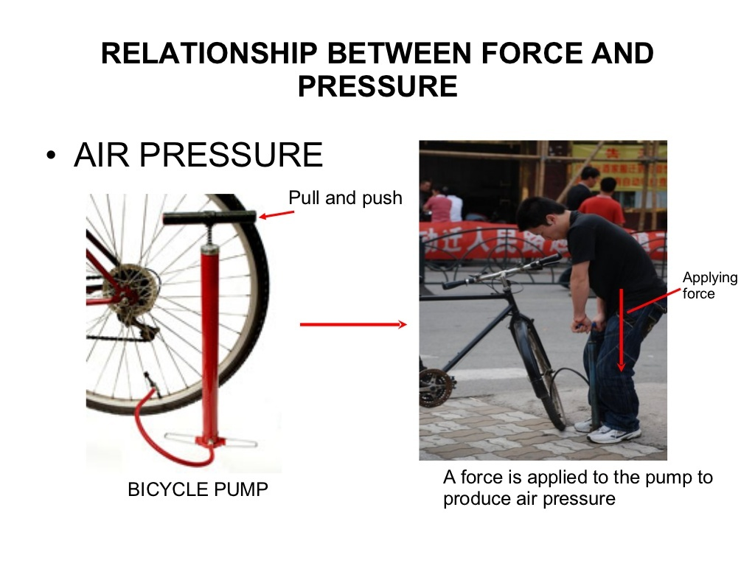

Slide 21
